Slide 1
Taiwan VPC Dashboard
Aug 2018

Slide 2
Taiwan VPC Capacity
HP X86 Model
HP ProLiant DL380 Gen9
44 Core/1TB
 | Model
Hardware model | X86 (44core, 1TB)
 |  |  | Core | RAM | Total server
Number of server | PDC | 5 | 220 | 5TB | 10
 | SDC | 5 | 220 | 5TB
HDS Gxx Model
HDS VSP G800
32 Core/256GB
 | Model
Hardware model | VSP G800 (32core, 256G)
 |  |  | Core | RAM | Total capacity
Number of storage | PDC | 1 | 32 | 256G | 112 TB 112 TB
 | SDC | 1 | 32 | 256G
Notes:
10% Utilization
Afford TPG move in
Model
Number
NBV
X3650M2
7
0
X3650M3
6
0
X3850X5
1
0
X3850M2
2
0
X3650M4
9
S$ 119,693

Slide 3
Taiwan VMs migrate to VPC
Target to move all Vmware, Windows and Linux to VPC
Total 75 VMs will be migrated to VPC
Total 95 VMs cannot be migrated will be excluded due to
Physical machine
Location/Technical constraint
78
11
25
51
6
42
42
Cannot be migrated
Vmware ESXi Server
Physical Server

Slide 4
Storage roadmap – online executing migration into HDS; AIX storage status quo on EMC VMAX
June
July
Aug
Sept
Oct
Nov
Dec
2019 Jan
Feb
Mar
x86 storage
HDS
G800
PDC : 57%
SDC : 57%
PDC : 70%
SDC : 70%
Unix, physical storage
EMC
VMAX
PDC : 61%
SDC : 55%
PDC : 48%
SDC : 48%
PDC : 5%
SDC : 3%
Start to migrate VPC

Slide 5
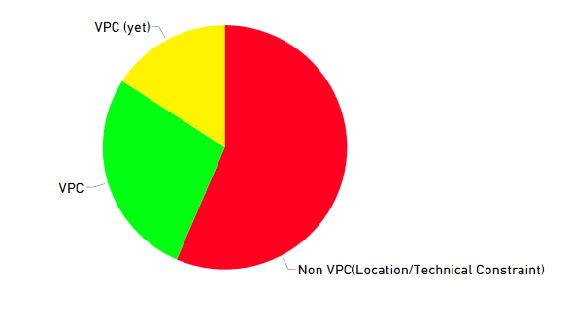
VPC STATUS(08/15)
Number of servers:59
15.86%
27.69%
56.45%
Number of servers:103
Number of servers:210
Total Number of servers：372

Slide 6
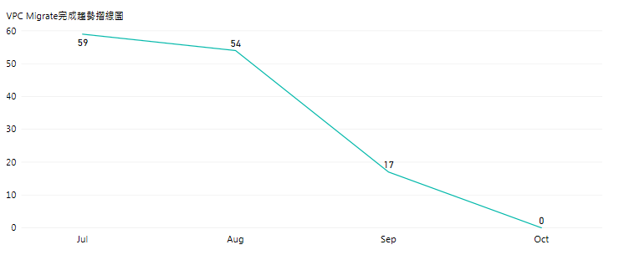
Trend of VPC Migration
Expected to completed all VPC migration in October 2018.

Slide 7
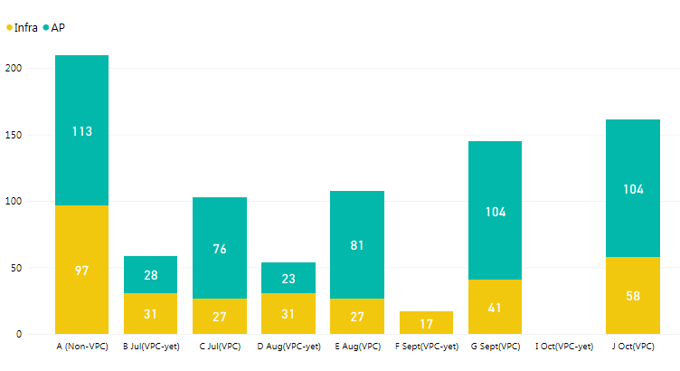
VPC Migrate Completed Mon.(forecast)
Month | Jul | Aug | Sep | Oct
AP teams completed number | 5 | 23 | 0 (completed) | 0
Infra teams completed number | 0 | 14 | 17 | 0 (completed)

